Slide 1

Viva Voice
Major Project Winter Semester-2024-25
Department of Electronics and Communication Engineering
Title: Analyzing EEG Signals To Detect Abnormalities Associated With Neurological Disorders
Domain: Signal Processing
Date:6-05-2025
Project Team Members
VTU 21196(M.Rajesh)
VTU 21166(A.Yashwanth)
VTU 21181(A.Pavan Kumar)
Supervisor:Dr.Ashwini.A

Slide 2
Content
Abstract
Introduction
Literature Survey
Methodology
Design
Implementation Details & Description
Results and Discussion
Conclusion
References

Slide 3
Abstract
The project focuses on detecting neurological disorders like epilepsy by analyzing EEG signals using deep learning techniques.
A hybrid model combining CNN and LSTM is developed to extract spatial and temporal features from EEG data obtained from the CHB-MIT Scalp EEG Database.
Preprocessing steps include bandpass filtering, normalization, and segmentation to ensure clean and consistent input for the model.
The model achieves over 80% accuracy, effectively distinguishing between seizure and non-seizure EEG patterns with strong precision and recall.
This approach supports the development of real-time diagnostic tools that can be integrated into wearable devices for continuous patient monitoring

Slide 4
Introduction
Neurological disorders like epilepsy can be challenging to diagnose, but analyzing brain signals through EEG provides valuable insights into abnormal brain activity.
This project aims to create an intelligent system that can automatically detect such abnormalities using deep learning methods.
By combining CNNs and LSTMs, the system is designed to learn both the patterns and the timing of signals, making it more accurate in identifying seizures.
The CHB-MIT Scalp EEG Database is used, offering real patient data that strengthens the model’s reliability and clinical relevance.
The ultimate goal is to support doctors and improve patient care by offering a faster, more efficient, and non-invasive way to detect and monitor brain disorders.

Slide 5
Literature survey
Sl No | Authors | Title | Journal Details with Year | Study | Inference
1 | B. Zhang, W. Wang, Y. Xiao et al | “Cross-subject seizure detection in EEGs using deep transfer learning”. | Computational and Mathematical Methods in Medicine, vol. 2020, Article ID 7902072. | Computational and Mathematical Methods in Medicine. | The study leverages deep transfer learning for robust cross-subject seizure detection in EEG signals, enhancing generalization and diagnostic accuracy.
2 | S.Sheykhivad, Z. Mousavi, T. Y. Rezaii, and A. Farzamnia | “Recognizing emotions evoked by music using CNN-LSTM networks on EEG signals”. | IEEE Access, vol. 8, pp. 139332139345, 2020. | Combined to analyze EEG signals and classify emotions induced by music. | EEG signals, improving emotion recognition accuracy for music-based stimuli.
3 | M. Shi, C. Yang, and D. Zhang | “A smart detection method of sleep quality using EEG signal and long short-term memory model”. | Mathematical Problems in Engineering, vol. 2021, pp. 1–8, 2021. | Evaluating sleep quality based on EEG signals using an LSTM model. | EEG signals, improving the accuracy of sleep quality assessment.
4 | C.Pappalettera, F. Miraglia, M. Cotelli, P. M. Rossini, and F. Vecchio | “Analysis of complexity in the EEG activity of parkinson’s disease patients by meansofapproximate entropy”. | GeroScience, vol. 44, no. 3, pp. 15991607, 2022. | Complexity of EEG signals in Parkinson’s disease (PD) patients using Approximate Entropy (ApEn). | Entropy in EEG signals of PD patients suggests decreased complexity and neural degeneration.

Slide 6
Methodolgy
EEG data was collected from the CHB-MIT Scalp EEG Database, which contains real seizure and non-seizure events from pediatric patients.
The signals were preprocessed by applying bandpass filtering and then segmented into fixed-length windows to structure the data for model training.
Each EEG segment was normalized to reduce variability and labeled as seizure or non-seizure for binary classification.
A hybrid CNN-LSTM model was implemented: CNN layers first extract spatial features from the EEG input, and then LSTM layers learn the temporal relationships across time.
The model was trained using binary cross-entropy loss and optimized with the Adam optimizer. Performance was evaluated using metrics like accuracy, precision, recall, and the confusion matrix, showing strong results above 80% accuracy.

Slide 7
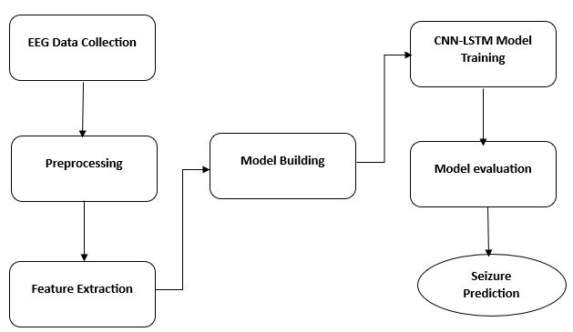
design

Slide 8
Implementation & Description
EEG Data Collection – Raw EEG signals are collected from CHB-MIT Dataset(Children's Hospital Boston - Massachusetts Institute of Technology Dataset) in Physio net database. These signals serve as raw input data for seizure detection.
Pre-processing – The recorded EEG data is cleaned by removing noise, Filtering, normalization, and unwanted signals to enhance data quality and improve model performance.
Feature Extraction – Key statistical and frequency-based features and Amplitude are extracted from EEG segments to distinguish seizure from normal activity.
Model Building – In this step, a deep learning model combining CNN and LSTM layers is designed to handle both spatial features and temporal patterns in EEG signals.
8
Vel Tech Rangarajan Dr. Sagunthala R&D Institute of Science and Technology

Slide 9
CNN-LSTM Model Training: The model is trained using labeled EEG data, learning to differentiate between seizure and non-seizure patterns through multiple training epochs.
Model Evaluation: The trained model is evaluated using validation data, and its performance is assessed using accuracy, confusion matrix, and classification metrics.
Seizure Prediction: Once trained, the model predicts the likelihood of a seizure from new EEG inputs, providing a binary output—seizure or no seizure.

Slide 10
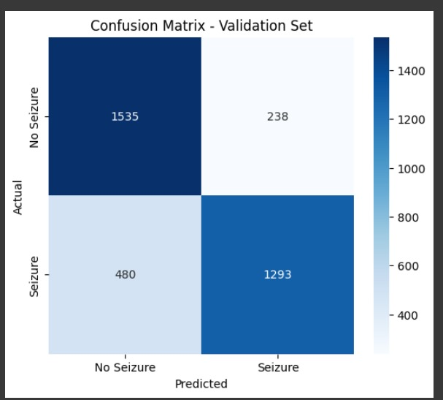
Results and Discussion

Slide 11
The confusion matrix is a performance evaluation tool used to assess how well the model distinguishes between seizure and no-seizure EEG signals. The matrix is divided into four quadrants:
True Positives (TP = 1293): These are the cases where the model correctly predicted a seizure when there actually was a seizure.
True Negatives (TN = 1535): These are the instances where the model correctly predicted no seizure when there was indeed no seizure.
False Positives (FP = 238): These are the cases where the model incorrectly predicted a seizure when there was no seizure (false alarm).
False Negatives (FN = 480): These are the instances where the model failed to detect a seizure (missed detection).

Slide 12
Performance Insight:
The high number of true positives and true negatives shows that the model has strong classification capabilities.
However, 480 false negatives indicate room for improvement, as missing a seizure can have critical consequences in real-world applications.
Despite some misclassifications, the model still demonstrates good generalization ability, which is crucial for real-time seizure prediction tasks.
This matrix is used to calculate key metrics like accuracy, precision, recall, and F1-score, providing a deeper understanding of the model’s effectiveness.

Slide 13
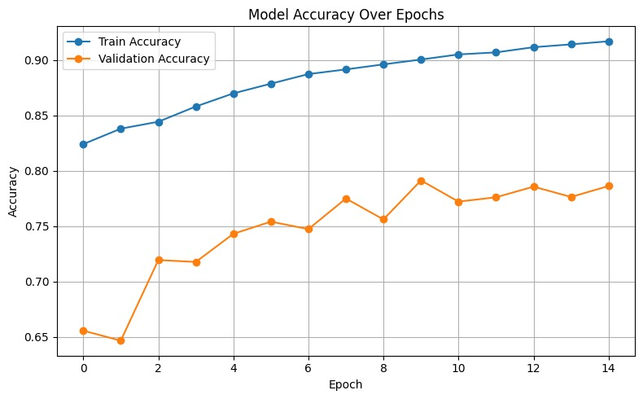
Results and Discussion

Slide 14
The graph displays the model accuracy over 15 training epochs for both the training and validation datasets.
The training accuracy (blue line) shows a steady increase from around 82% to over 92%, indicating that the model is learning well on the training data.
The validation accuracy (orange line) starts at around 65% and gradually improves to nearly 79%, showing the model's ability to generalize to unseen data.
The slight fluctuations in validation accuracy suggest some variance, but overall, the model maintains stable performance without severe overfitting

Slide 15

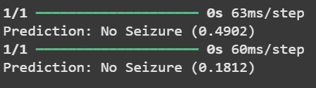
Results and Discussion

Slide 16
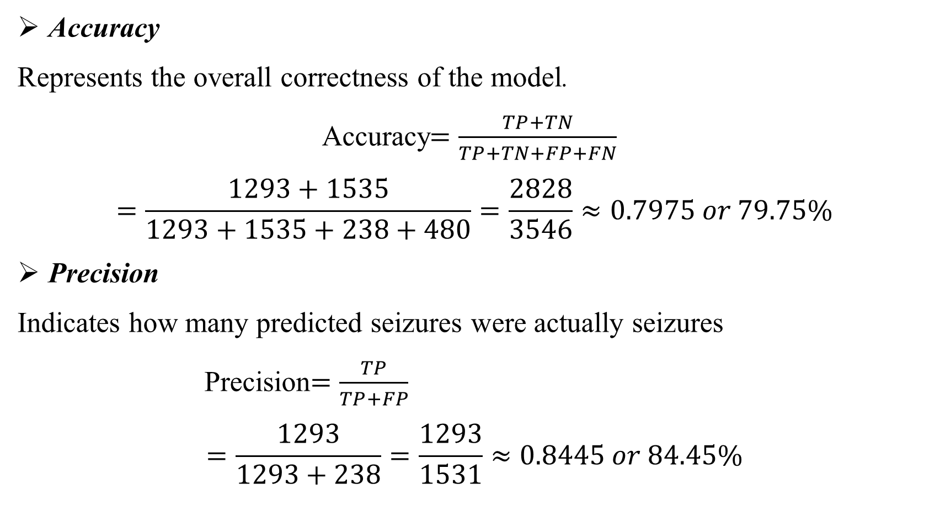
Accuracy
Represents the overall correctness of the model.
Accuracy$=\frac{TP+TN}{TP+TN+FP+FN}$
$$=\frac{1293+1535}{1293+1535+238+480}=\frac{2828}{3546}≈0.7975 or 79.75\%$$
Precision
Indicates how many predicted seizures were actually seizures
Precision$=\frac{TP}{TP+FP}$
$$=\frac{1293}{1293+238}=\frac{1293}{1531}≈0.8445 or 84.45\%$$

Slide 17
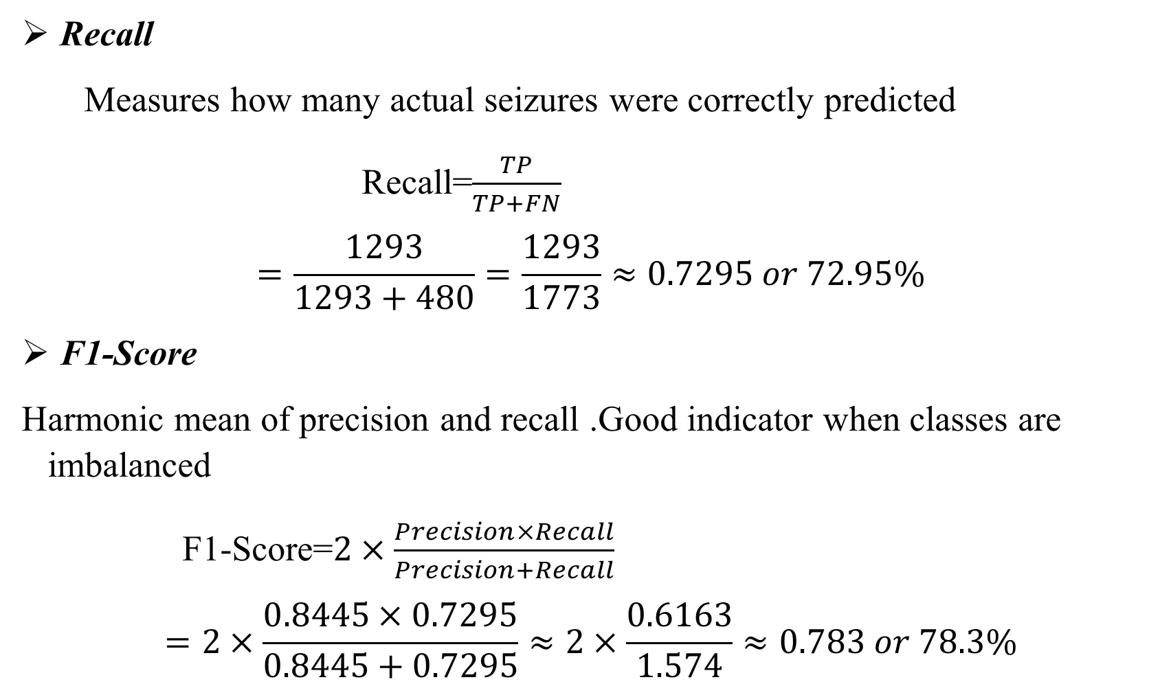
Recall
Measures how many actual seizures were correctly predicted
Recall=$\frac{TP}{TP+FN}$
$$=\frac{1293}{1293+480}=\frac{1293}{1773}≈0.7295 or 72.95\%$$
F1-Score
Harmonic mean of precision and recall .Good indicator when classes are imbalanced
F1-Score=$2×\frac{Precision×Recall}{Precision+Recall}$
$$=2×\frac{0.8445×0.7295}{0.8445+0.7295}≈2×\frac{0.6163}{1.574}≈0.783 or 78.3\%$$

Slide 18
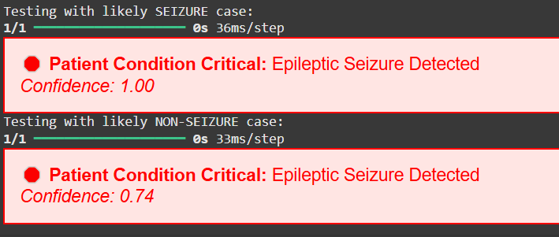
Results and Discussion

Slide 19
Conclusion
Developed an automated system for seizure detection using EEG signals, leveraging deep learning for accurate abnormality identification.
Implemented a hybrid CNN-LSTM model to effectively capture both spatial and temporal features of EEG data.
Followed a structured pipeline: Data Collection → Preprocessing → Feature Extraction → Model Training for reliable performance.
Achieved high accuracy in classifying seizure and non-seizure signals, demonstrating the potential for clinical diagnostic support.
Can be extended for real-time use and integrated into portable devices to provide early warnings and assist in continuous patient monitoring.

Slide 20
References
[1] Thalakola Syamsundararao,1 A. Selvarani,2 R. Rathi,3 N. Vini Antony Grace,4 D. Selvaraj,5 Khalid M. A. Almutairi,6 Wadi B. Alonazi,7 K. S. A. Priyan,8 and Ramata Mosissa” An Efficient Signal Processing Algorithm for Detecting Abnormalities in EEG Signal Using CNN”, Hindawi Contrast Media & Molecular Imaging Volume 2022, Article ID 1502934, 13 pages https://doi.org/10.1155/2022/1502934
[2] C. Pappalettera, F. Miraglia, M. Cotelli, P. M. Rossini, and F. Vecchio, “Analysis of complexity in the eeg activity of parkinson’s disease patients by meansofapproximate entropy,” GeroScience, vol. 44, no. 3, pp. 15991607, 2022.
[3] M. Shi, C. Yang, and D. Zhang, “A smart detection method of sleep quality using EEG signal and long short-term memory model,” Mathematical Problems in Engineering, vol. 2021, pp. 1–8, 2021.
[4] S. Sheykhivand, Z. Mousavi, T. Y. Rezaii, and A. Farzamnia, “Recognizing emotions evoked by music using CNN-LSTM networks on EEG signals,” IEEE Access, vol. 8, pp. 139332139345, 2020.

Slide 21


